Slide 1


How To Use Data Analytics?
LÊ TRỌNG NHÂN
trongnhanle@hcmut.edu.vn
trongnhanle85@gmail.com

Slide 2
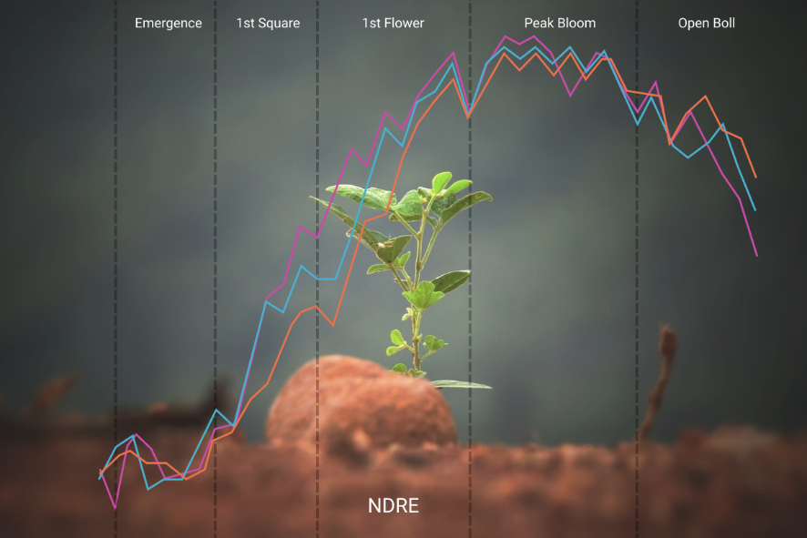
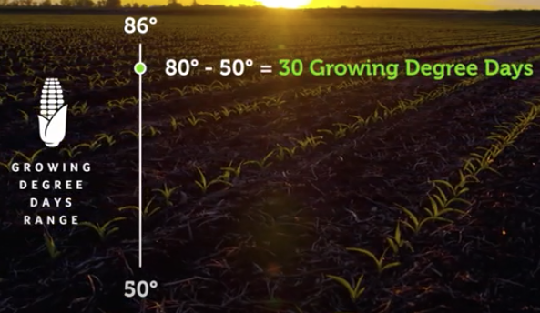
Introduction to Simple Data Analytics
Growing degree days (GDD) is a weather-based indicator for assessing crop development.
It is a function of many sensors: light, humidity, v.v…
A simple function is proposed for this feature
GDD is published to the IoT server as an additional information (or an advanced sensor)

Slide 3
Part 1: Evaluation Function in Python

Slide 4
Step 1: Working with eval()
Create a python file (e.g. eval_testing.py)
print("Test Eval")
def modify_value(x1, x2, x3): result = eval(equation) print(result) return result
a = 5 modify_value(a,2,3)

Slide 5
Potential Features using eval()
Derive more data from raw values:
AQI value from some standard values (temperature, humidy, PM2.5, PM10, ….)
The car parking is full or not?
Sensor calibration

Slide 6
Part 2: Intergrate eval function

Slide 7
Content
Create one more feed in Adafruit IO, e.g equation
Your equation will be published to the server manually
In the python source code:
Subscribe to receive the value, which is in string
Check the topic when data is received
Perform HTTP Get to receive the last data since MQTT is only activated when there is a data, which is published
Commit your project to Github

Slide 8
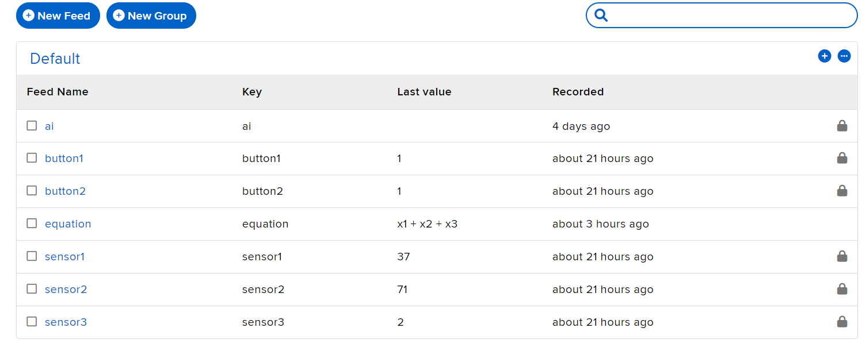
Step 1: Create a new Feed, named equation
Add an equation for testing, e.g. x1 + x2 + x3
Set the privacy of the feed to public

Slide 9
Step 2: Subscribe to the equation
def connected(client): print("Server connected ...") client.subscribe("button1") client.subscribe("button2") client.subscribe("equation")

Slide 10
Step 3: Implement the message()
global_equation = "“ #global variable
def message(client , feed_id , payload): print("Received: " + payload) if(feed_id == "equation"): global_equation = payload print(global_equation)

Slide 11
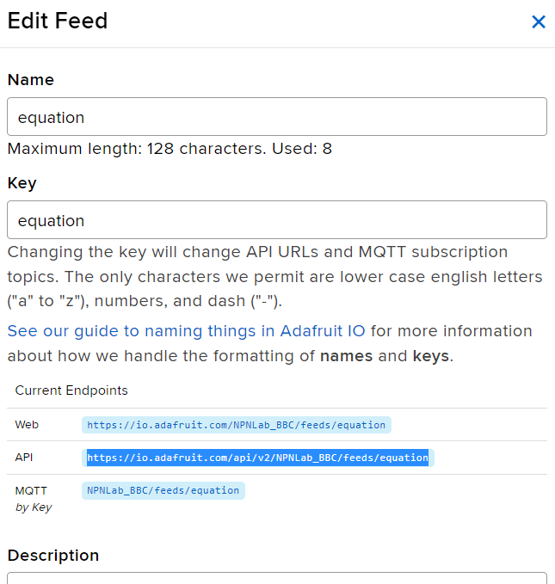
Step 4: Implement the HTTP Get
Copy the API

Slide 12
Step 4: Implement the HTTP Get
def init_global_equation(): headers = {} aio_url = “YOUR API" x = requests.get(url=aio_url, headers=headers, verify=False) data = x.json() global_equation = data["last_value"] print("Get lastest value:", global_equation)

Slide 13
Step 5: Intergrade the project
Generate 3 random values
Calculate the next value, based on these 3 values

